Slide 1
Singapore Tourism Board Analysis
Alvin Lim

Slide 2
Overview
Background information
Problem statements
Technical
Non-technical
Recommendations
Notes:
Since the questions given in the assignment focuses on technical aspects but also require me to present the insights to a marketing team, who I assume is a non technical audience. I have ordered my presentation where by I can answer technical aspects such as explaining issues with the data etc. and what features I have created to achieve my analysis.
After which, I will show various illustration created to show to the non technical audience what insights I have found, and lastly some recommendations for Singapore Tourism Board’s marketing team on their strategy to increase visitorship and spend in Singapore

Slide 3
Background information
The dataset provided contains the following:
Year, month
Purpose of visit
Mode of transport
Length of stay
Travel type (Packaged vs. non packaged tour)
Martial Status
Occupation
Shopping and other expenses
Whether they travelled alone
Notes:
Singapore tourism sector is growing at a fast pace. Tourism is not only a kind of leisure as it is also essential in a country's economy. In this analysis, I investigate Singapore’s tourist spending behaviours and preferences.
Firstly, I will go through give a quick run-through about what the dataset is about. The dataset used in this presentation is from 2018, it contains all of these variables.

Slide 4
Problem statements
Understand Singapore’s tourist spending behaviours and preferences
Is there a strong or weak relationship between travel companions and choice of hotel?
How many different segment of visitors can be identified from the survey data

Slide 5
Technical - Workflow
Step 3: Impute/remove missing values and transforming of variables
Step 1: Import data using CSV format
Step 5: Briefly summaries the model findings and insights
Import data
Descriptive data
Data Transformation
Selecting predictors and models
Analyze different predictive models
Step 2: Understanding the data structure and variable type
Step 4: Select model(s) that is most appropriate for the dataset.
Notes:
Describe the analytical approach you will take and data fields you would look into when it comes to doing exploratory data analysis.
Highlight the data idiosyncrasies / issues you found in this dataset and how would you address the issues identified.
What are the considerations that you will take when analysing survey data.
Please explain the choice of metric you used
What are the key assumptions you have taken to identify the different segments?
What were the other approaches you considered? Please explain the reason for the technique / approach used as well as the pros and cons.
Why is your analytical approach performing well / not well?
Was any feature engineering required? If yes, what were they. If no, why?

Slide 6
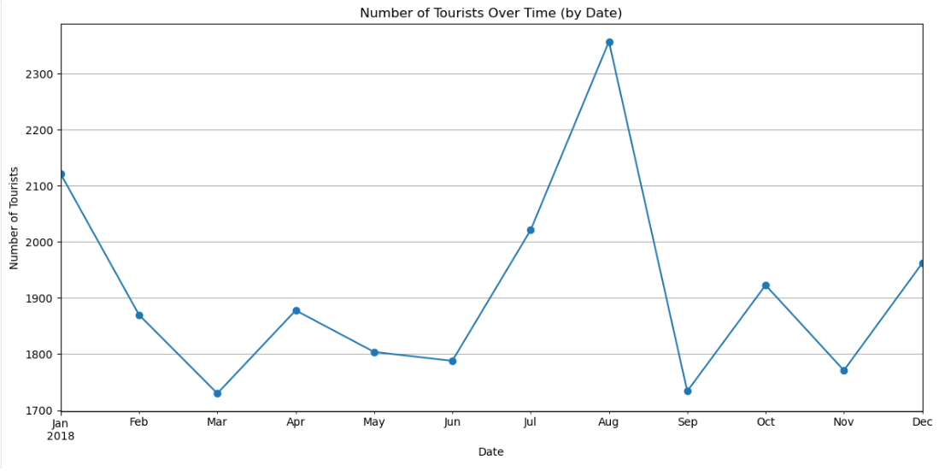

Slide 7
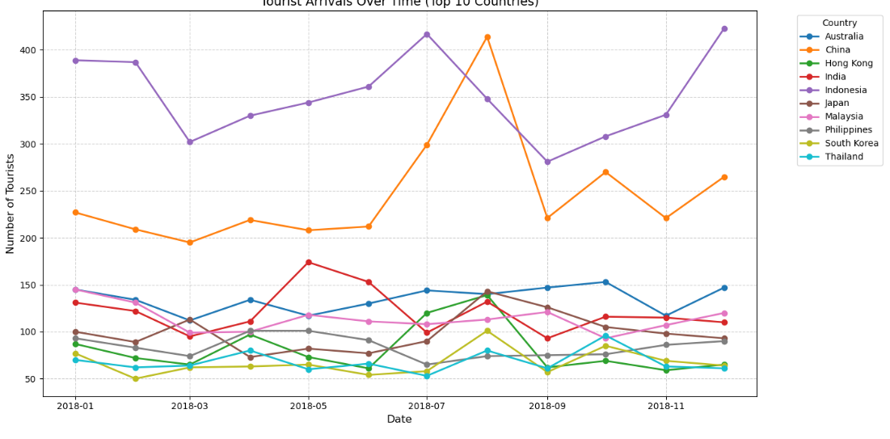

Slide 8
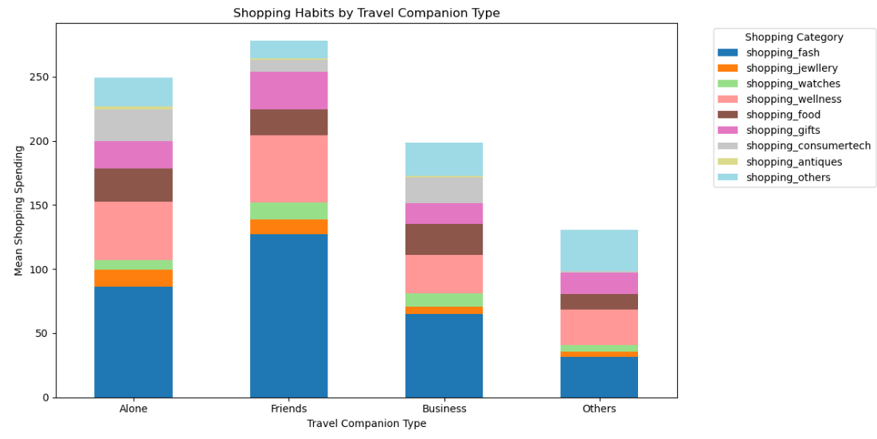

Slide 9
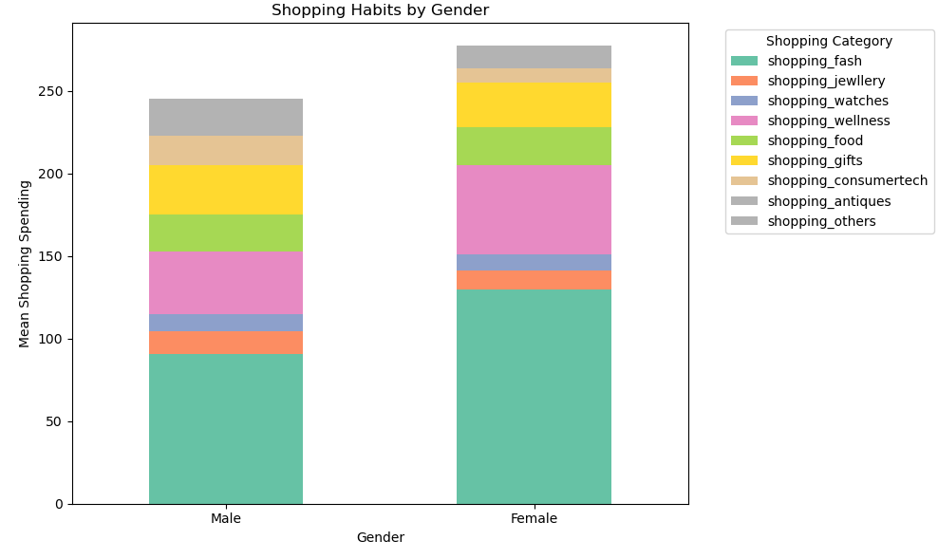

Slide 10
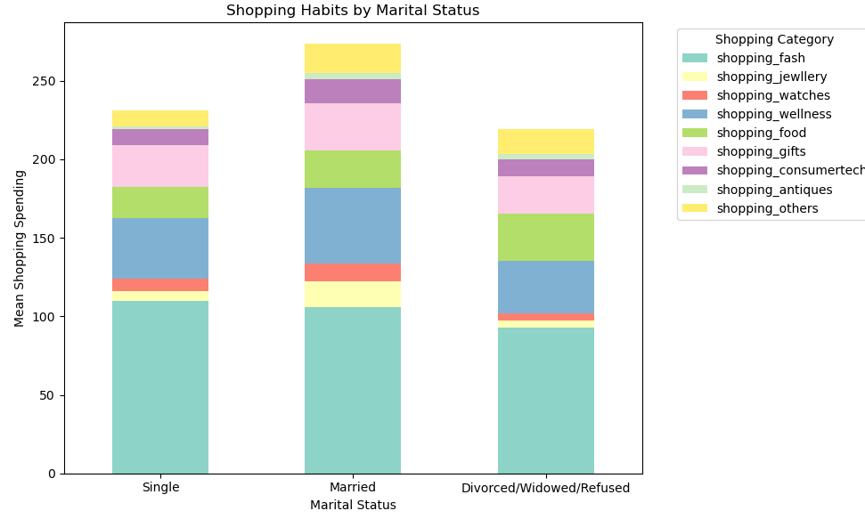

Slide 11
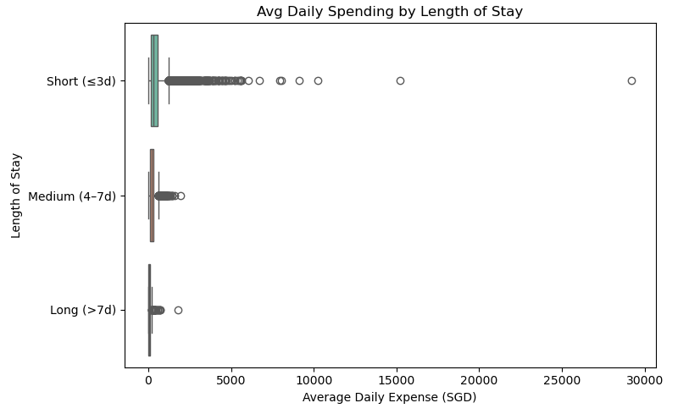

Slide 12
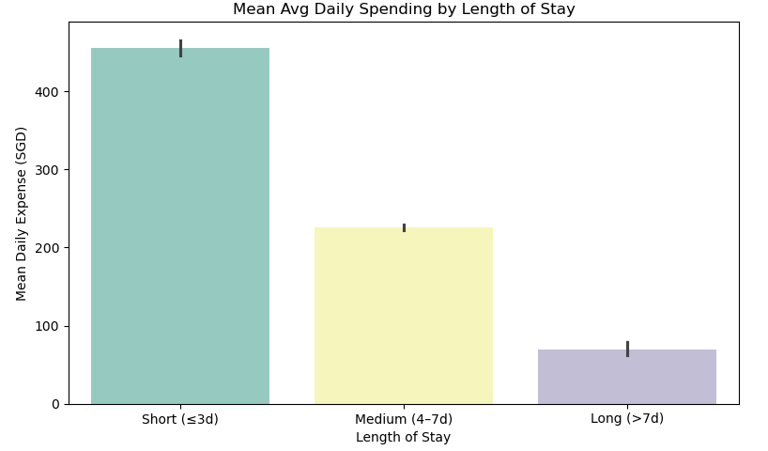

Slide 13
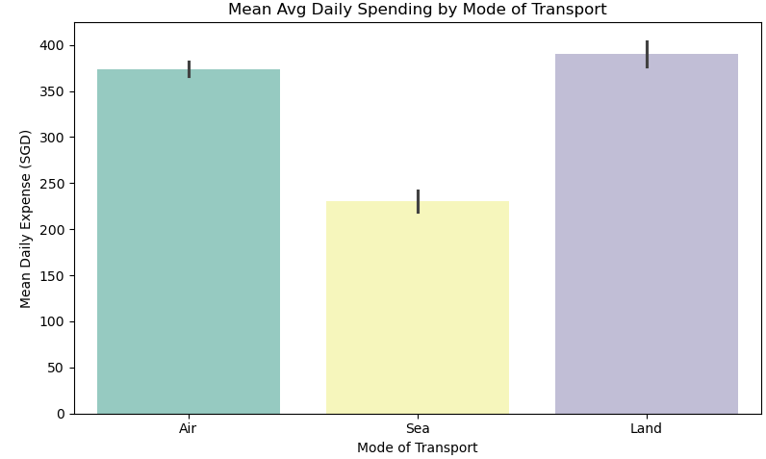

Slide 14
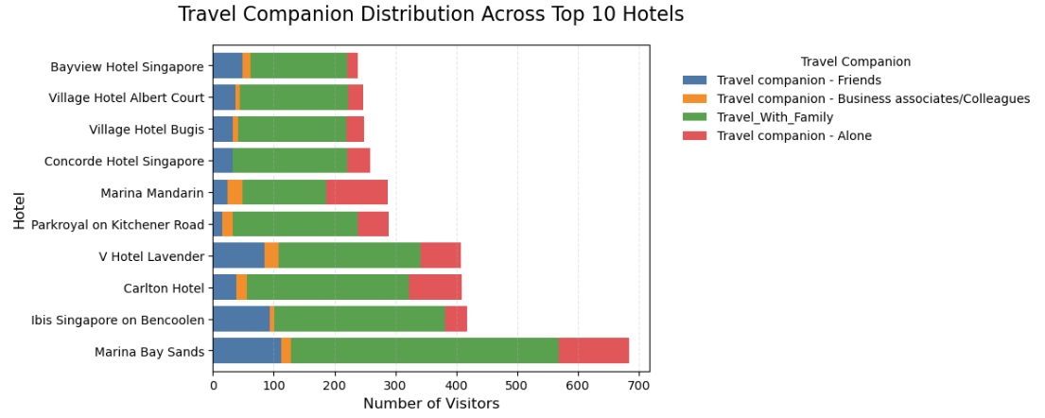

Slide 15
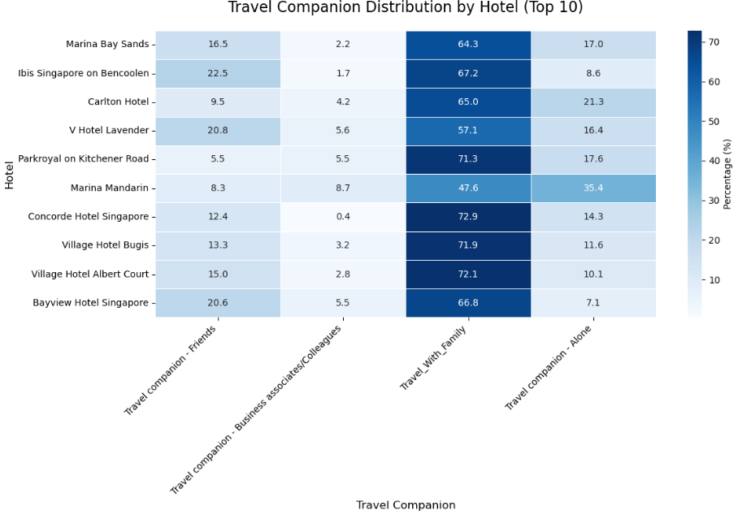
Notes:
=== Results === Chi-square: 245.5 p-value: 0.0000 Degrees of freedom: 27 Cramer's V: 0.153

Slide 16
Key issues with the dataset
Variable | Issues | Example
Air_Terminal, Sea_Terminal, Land_Terminal
MainHotel
 | Outliers in spending

